Slide 1
Predicting women’s basketball naia player efficiency
Modeling the Championship Profile: A Six-Year Comparative Analysis of NAIA Champions vs. UPIKE Women's Basketball.
Magdalena Vicencio
MTH 106
Dr. Holcomb

Slide 2
WHY THIS TOPIC?
I am passionate about sports, especially basketball
I had previously completed a similar project in my Intro to Data Science class
This project was a natural continuation of that earlier work
I’m fascinated by finding mathematical solutions to sports inefficiencies

Slide 3
The Collegiate Challenge: Evaluating Success in the NAIA
It is challenging to evaluate success in the NAIA because the league is less widespread than others, like the NCAA, and available data is limited
Even at the NCAA level, statistics are not nearly as advanced as those used in professional leagues such as the NBA
There is significant opportunity to develop and implement algorithms and tools that can generate and display advanced statistics at this level of play
Notes:
Put another reason

Slide 4
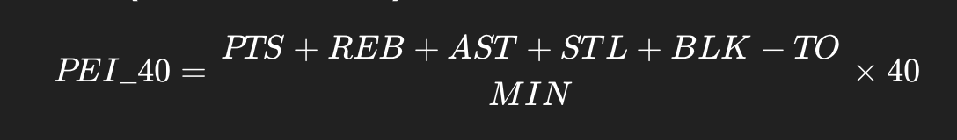
Introducing the Player efficiency index
The catalyst for this analysis is a statistic called PEI, or Player Efficiency Index
I chose PEI because it combines shooting, rebounding, and ball security into a single value
Since NAIA women’s basketball games are 40 minutes, I standardized all values accordingly and simplified an NBA formula and called the result PEI_40
Which led me to the following calculation:

Slide 5
PROJECT METHODOLOGY
To predict Women’s Basketball NAIA player efficiency, I’m comparing six years of UPIKE stats with six years of stats from the most recent NAIA National Champions. The idea is to use the champions’ success as a blueprint, so I can discover a predictor of efficiency that helps estimate UPIKE’s future performance through my predictive modeling.
1. Data Collection & Conversion Gathered 12 season PDF files (6 National Champions, 6 UPIKE) and converted them into CSV format.
2. Data Cleaning & Metric Creation Loaded all CSVs into Excel, organized the data, and calculated my North Star metric PEI_40, along with additional advanced statistics.
3. Data Integration Using Python Imported the cleaned dataset into a Pandas DataFrame using the skills from my Data Science minor.
4. Modeling & Visualization Built a linear regression model (Ridge Regression) and generated all the graphs and visuals included in this presentation.

Slide 6
Naia national champions from 2018 to 2025
MONTANA WESTERN
2018-19
THOMAS MORE
2021-22
CLARKE
2022-23
DORDT
2023-24
DORDT
2024-25
WESTMONT
2020-21
For context, this are the last 5 teams that have won the NAIA National championship on the past 6 years (not counting the COVID year, where the tournament wasn’t held due to the pandemic.
One interesting fact, is that statistically speaking Dordt, now 2x National Champion and UPIKE had very similar stats until 2018, where they just exploded into being, first a National championship contenders, and then on the last 2 years, National champs

Slide 7
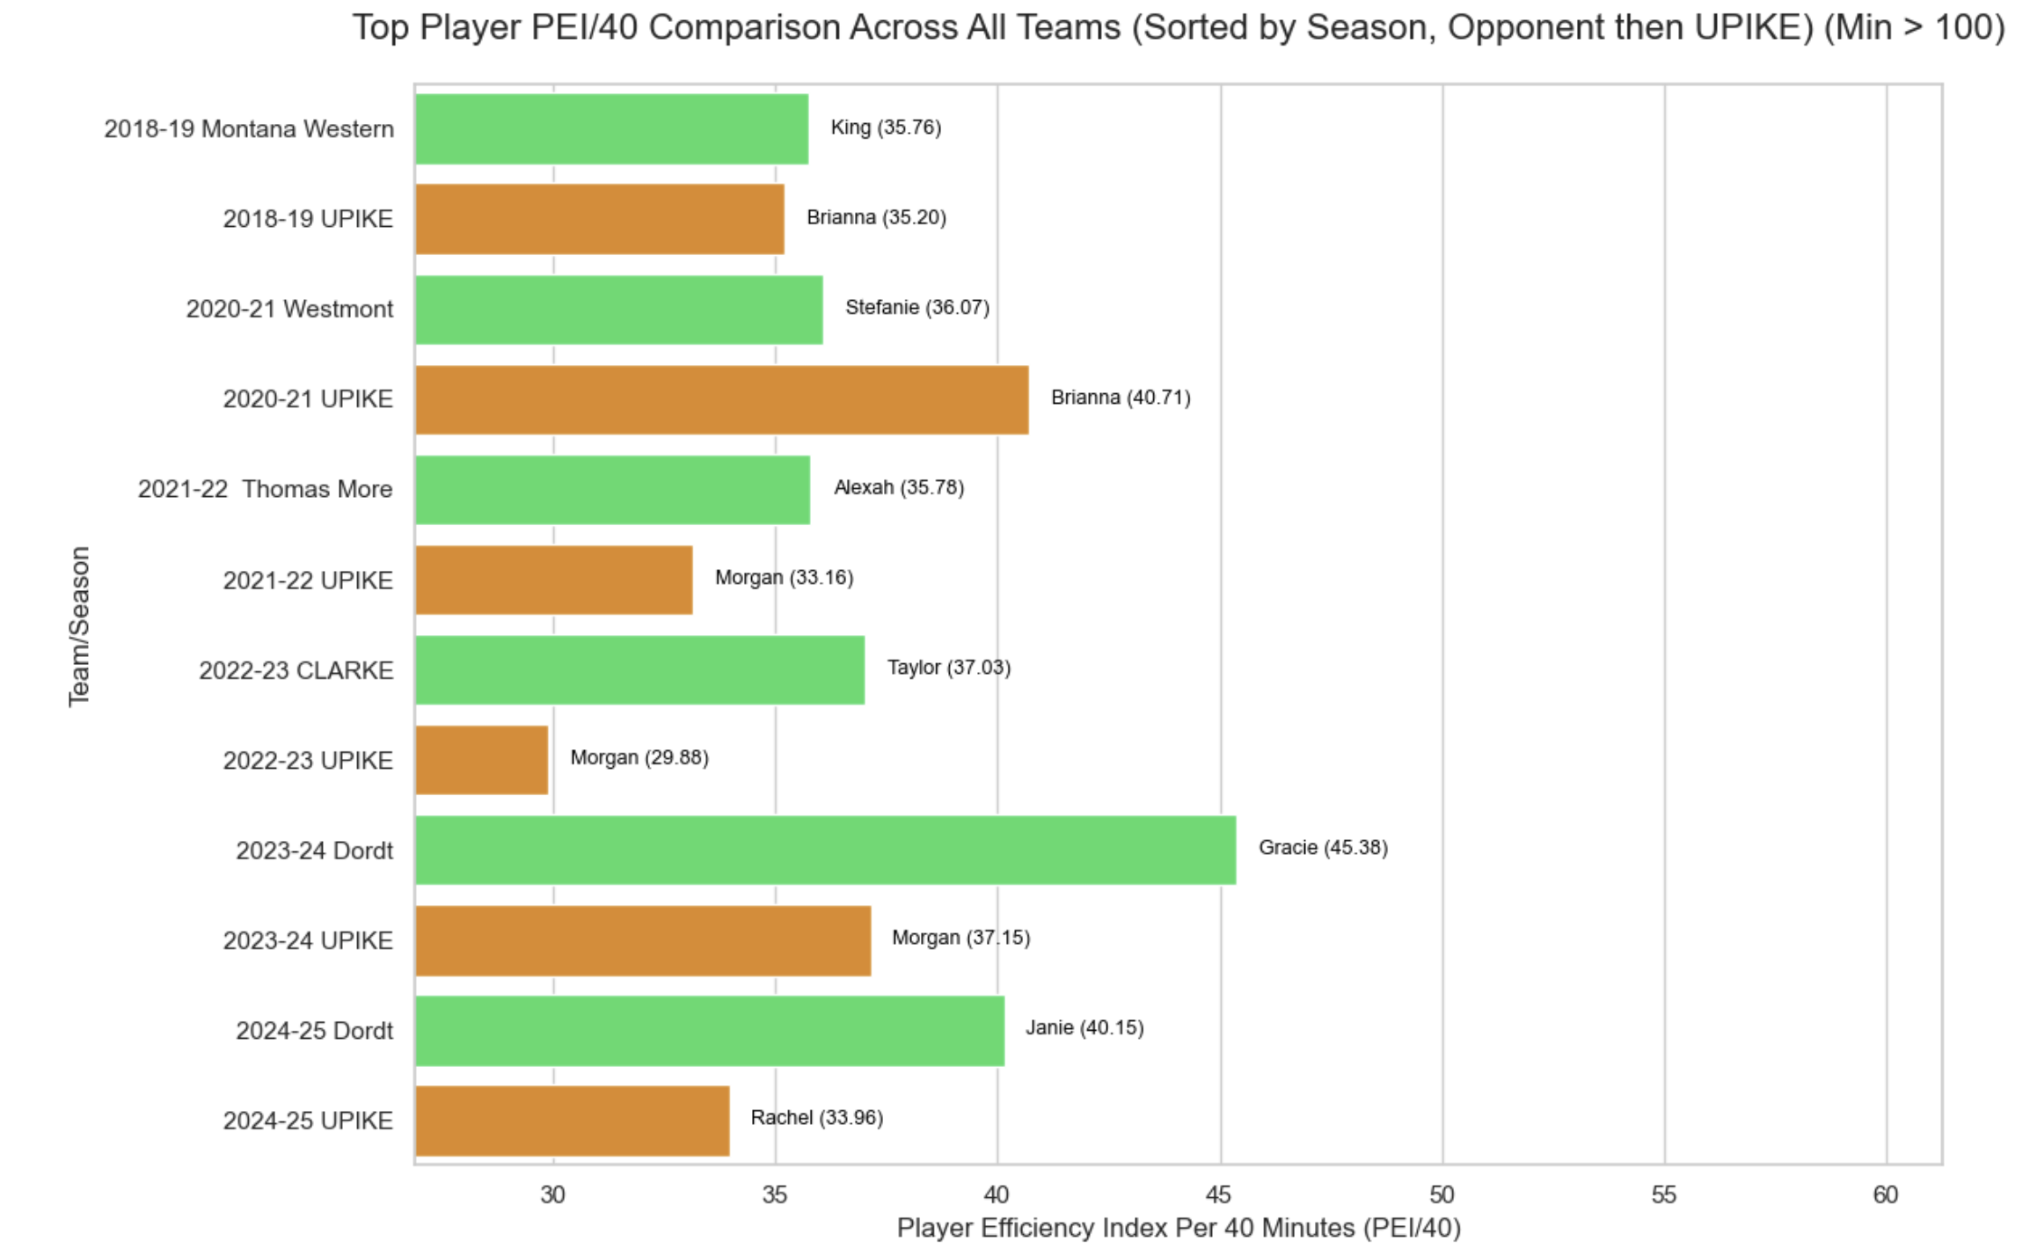
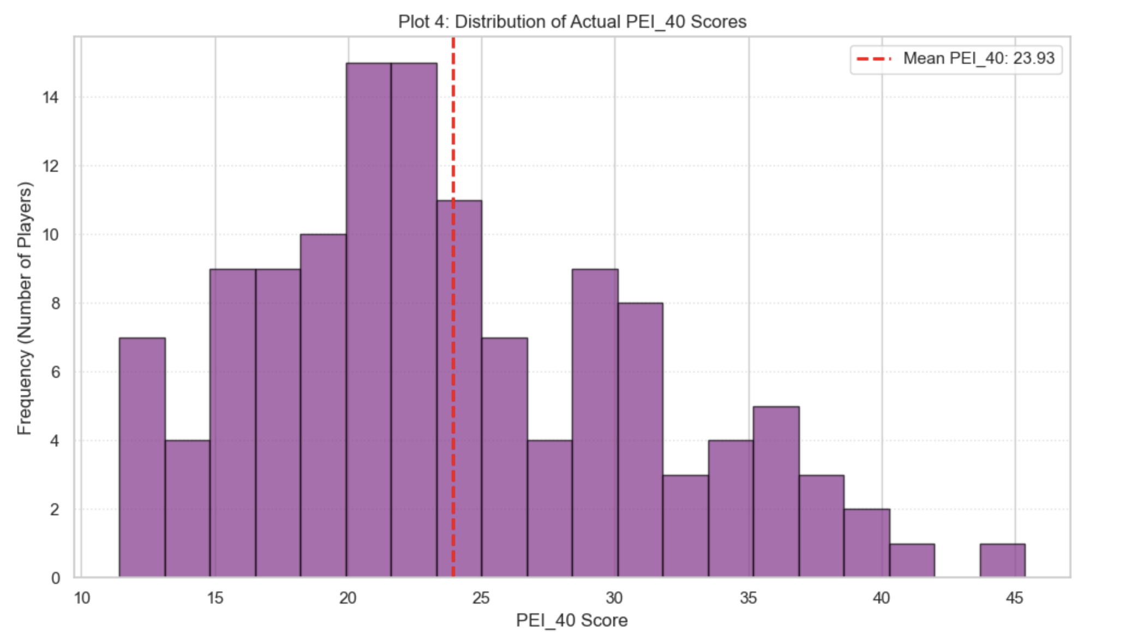
Further analysis: Comparing pei_40
To get a preliminary sense of how my sample was distributed, I decided to start by creating these two graphs:
To compare the best player from each team, I graphed the top performer based on their PEI_40.
As I expected, the National Champions consistently show a much higher PEI_40, which reflects their greater overall efficiency.
One interesting finding is that only in the 2020–21 season did UPIKE’s top player outperform that year’s National Champion in PEI_40.
To look at the overall distribution of PEI_40 in my dataset, I graphed a histogram of all the values.
The mean PEI_40 came out to 23.93, which represents what an average player would look like in this sample.
As expected, since the dataset includes players from National Championship teams, there are 83 players who fall above that average.

Slide 8
feature SELECTION
The next step in my project was choosing which features to include in my model. I focused on two things: selecting the stats that had the strongest correlation with PEI_40, while also avoiding multicollinearity, and making sure I represented all areas of the game.
Multicollinearity became an issue when I ran my first correlation analysis. Since PEI_40 is calculated from several basic stats (as shown in the formula on slide 4), many of those stats were highly correlated with PEI_40. Including them as features would have created multicollinearity problems in my prediction model, so I had to be selective with which variables I kept.
Now that I’ve selected my features, I want to briefly show the formulas behind each of them, just to give some mathematical context to how these stats are calculated.

Slide 9
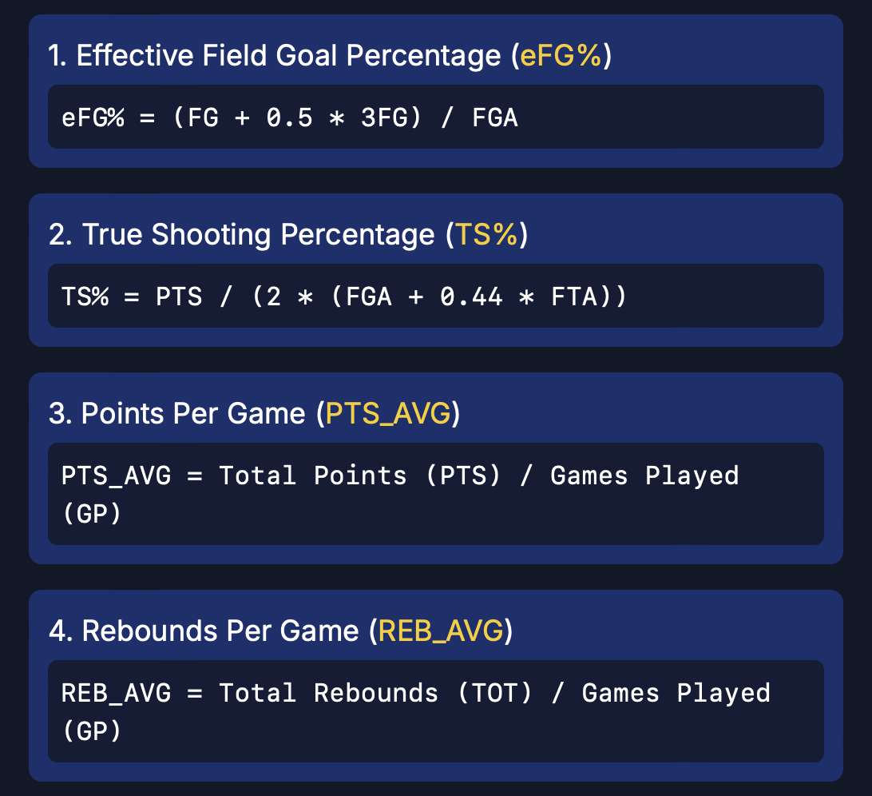
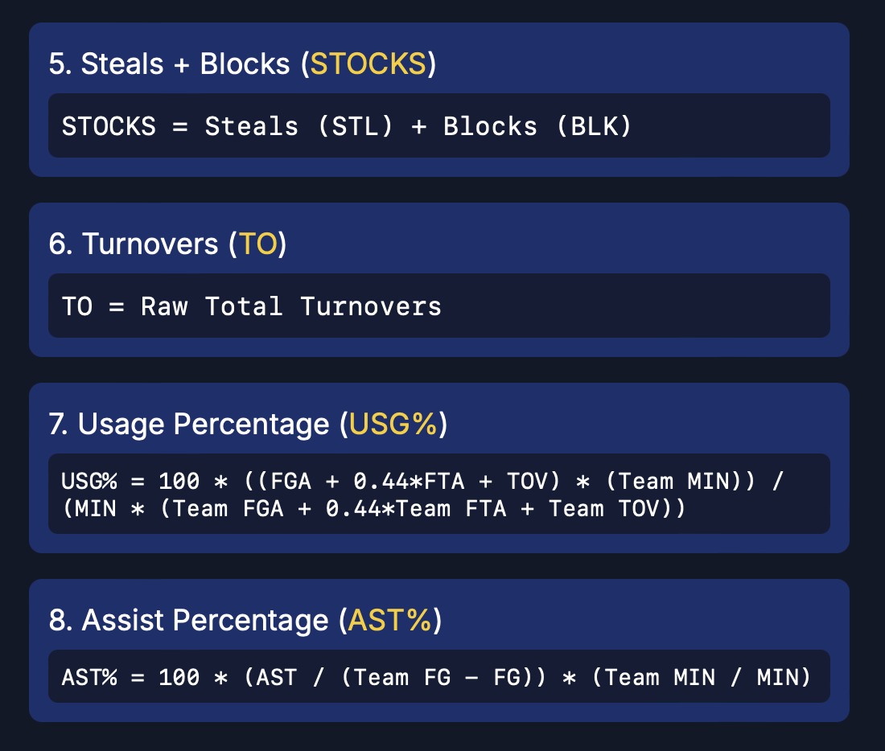

feature SELECTION: FORMULAS

Slide 10
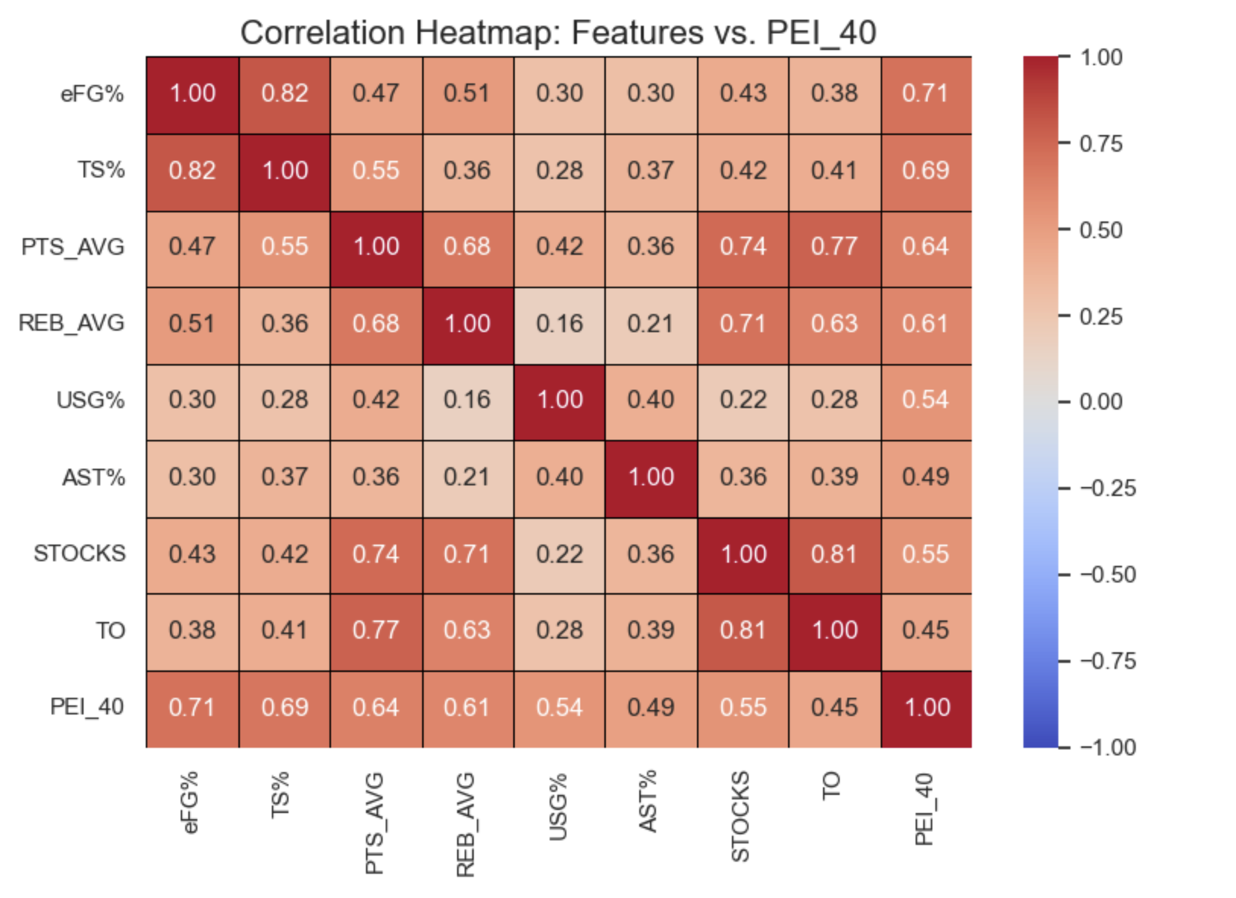
feature SELECTION: THE CORRELATION MATRIX
After analyzing 40 features I select 8 of them
eFG% (0.71) and TS% (0.69) showed the strongest positive correlation with PEI_40.
I explicitly included Turnover Rate as a negative volume metric to penalize inefficient play.
The heatmap reveals strong clusters around shooting efficiency and usage, guiding our model inputs.

Slide 11
Model Methodology: Linear Regression for Quantification
My goal was simple: create an equation that uses my 8-input metrics (like eFG% and USG%) to predict a player’s PEI_40. I first started with a Standard Linear Regression model, but the 𝑅² and MSE results weren’t strong enough.
So, I moved on to a Ridge Regression model. This ended up being exactly what I needed, because even though I had already reduced most of the multicollinearity when selecting features, some of the stats were still closely related. Ridge Regression helps with that by penalizing those highly correlated coefficients, which makes the model perform better and more reliably.
By adjusting the alpha parameter—the amount of penalization—I was able to tune the model and get results that were both accurate and satisfactory.
To further eliminate possible statistical noise, I filtered out players that played less than 100 minutes in their seasons

Slide 12
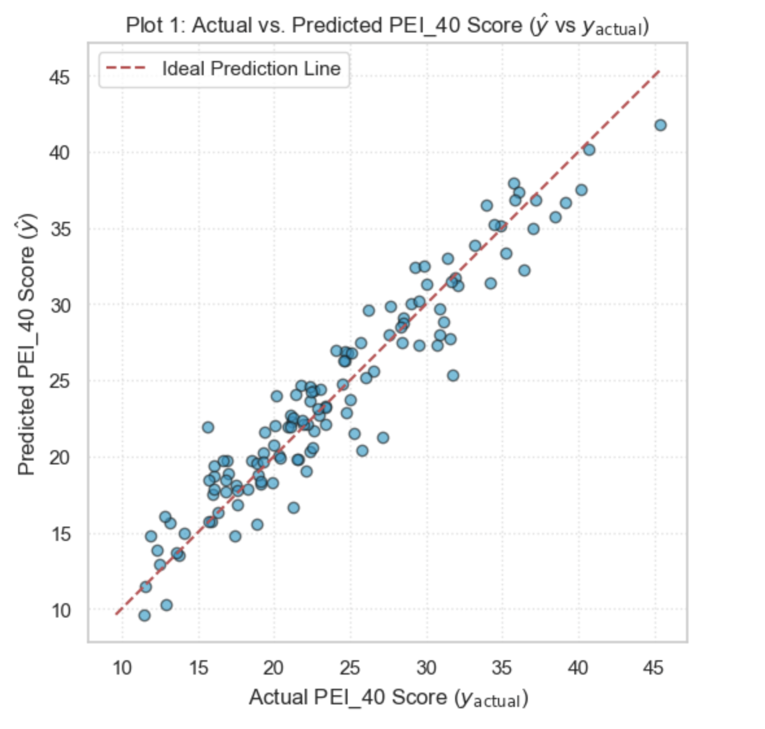
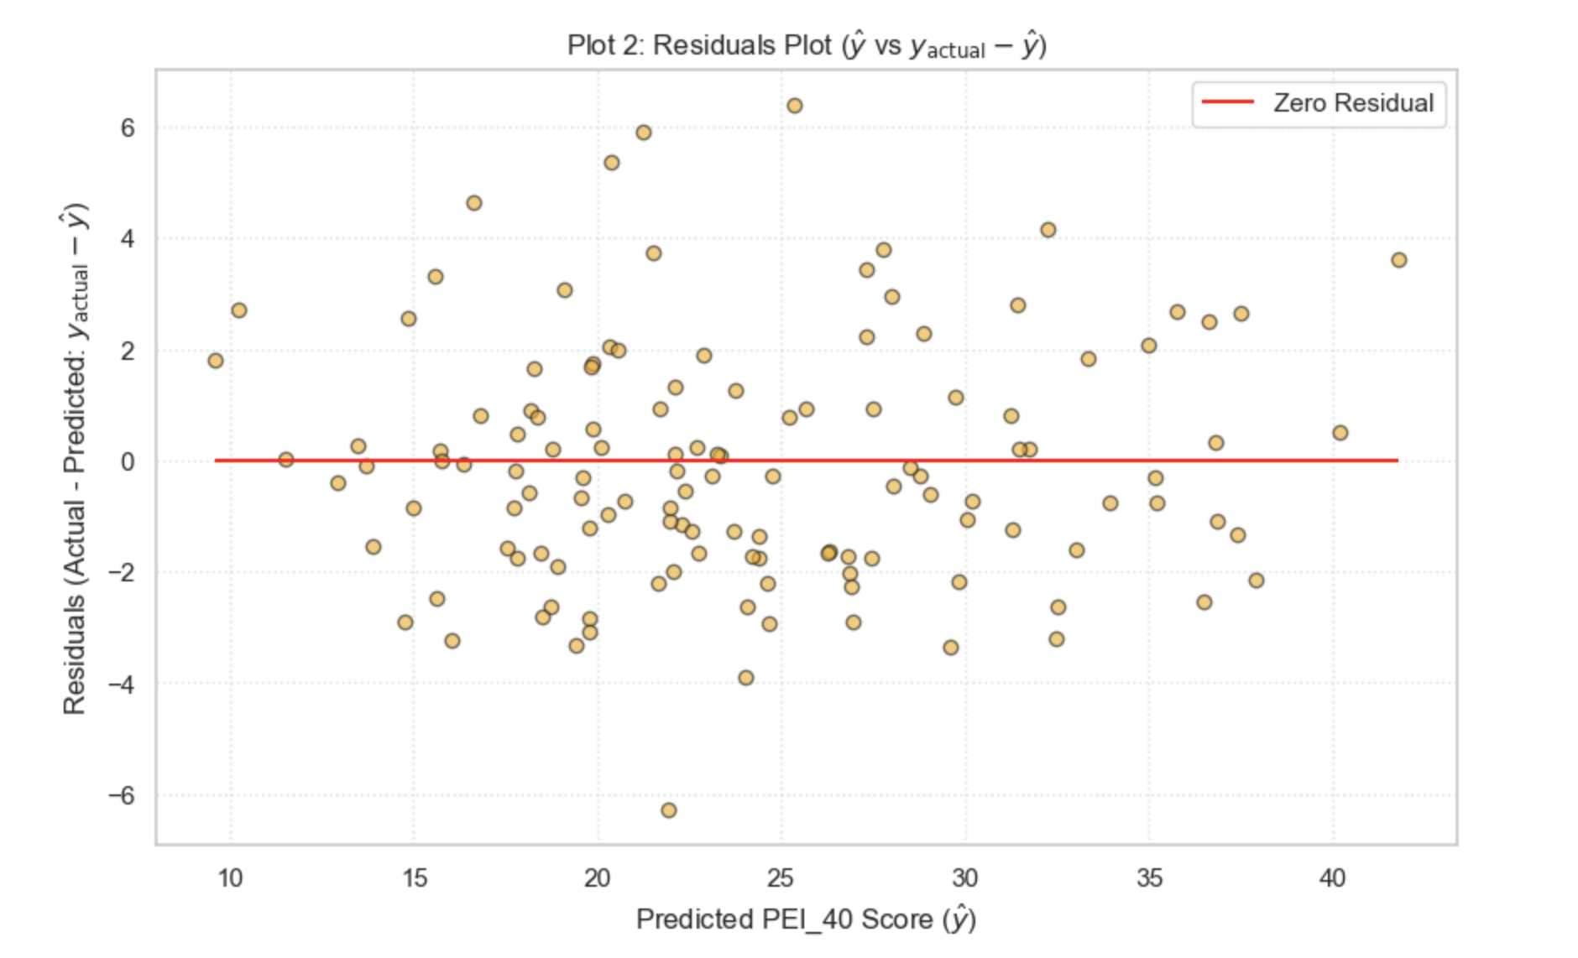
Model validation: r2 AND MSE
Residual Analysis: Errors are randomly distributed (MSE = 3.99), confirming the model is unbiased.
Our Ridge Regression model explains 93.3% of the variance in player efficiency. Which was a very good result for the amount of heterogenous data that I gathered (13 different teams across 6 years)
Tight clustering along the diagonal indicates high accuracy.

Slide 13
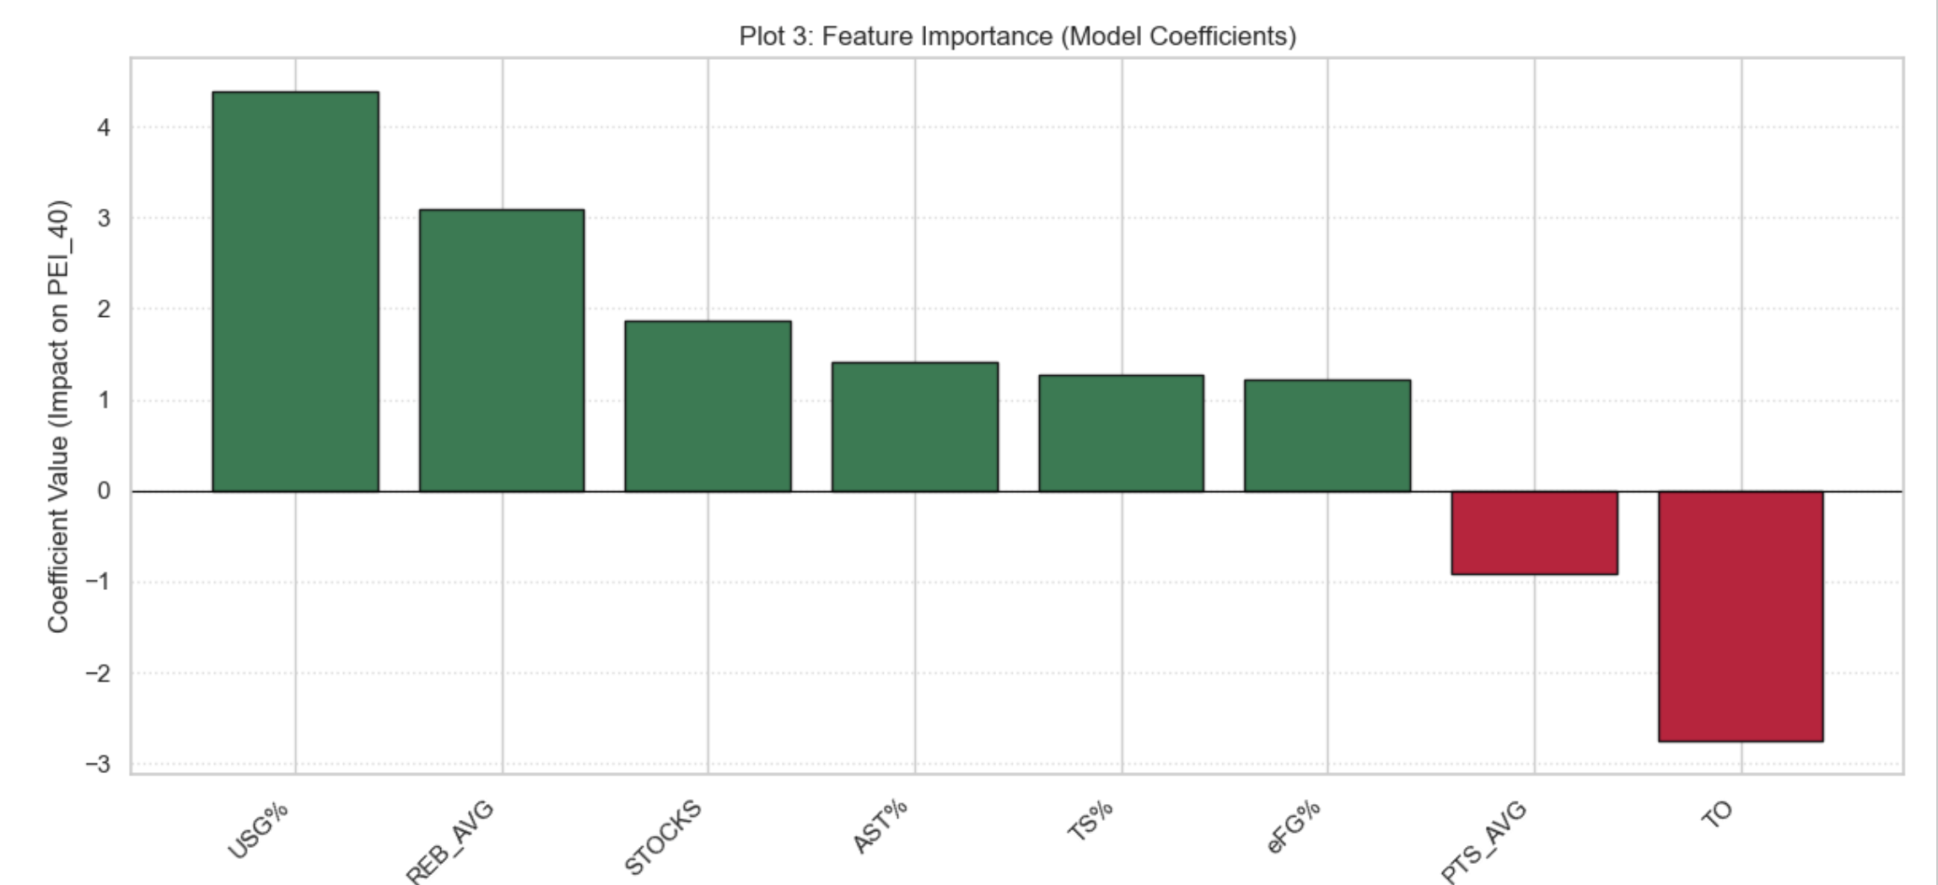
The Championship Blueprint: Mathematical Weights of Success
With my analysis and correlation study, I was able to identify which features—out of the 8 I selected—ended up being the most important when predicting efficiency.
USG% (+4.39): The single biggest driver. To be able to succeed in the NAIA, teams need players who actively demand the ball and produce when they get it.
Rebounding (+3.09):Board work is seriously undervalued. Players who rebound at a high rate make a strong contribution to PEI, and it really shows in the model. This suggests that recruiting taller players—or players who are simply strong rebounders—should be a major priority, especially in a league where height is not very common.

Slide 14
The Championship Blueprint: Mathematical Weights of Success
Turnovers (-2.76): As expected, high turnovers negate high scoring.
PTS_AVG (-0.90): This was one of my biggest discoveries in the entire project. I originally assumed that having a higher volume in a positive statistic automatically meant a player was better. But I learned that it’s not the volume itself—it’s the volume relative to how many attempts it took to get there.
With that in mind, efficiency stats like USG% and eFG% ended up being much stronger predictors of success than simple volume stats like average points. (Afterward, I looked into it more and realized this is actually well-known at the NBA level.)

Slide 15
IMPLEMENTING THE MODEL IN ORDER TO PREDICT NAIA PLAYER EFFIC
To test the validity of my model—and to see if it could actually be used as a tool to help grow our UPIKE women’s basketball team—I created two deliverables
Deliverable 1: A tool that allows our coach to calculate each player’s PEI_40 and see how it would change if a player increased or decreased their performance in any of the 8 selected modeling features. I called it the ‘What if’ Engine
Deliverable 2: Building on Deliverable 1, I developed a lineup-optimization program that calculates the highest possible combined PEI_40, helping identify the most efficient lineup for the team.
CHALLENGES
A big challenge came up when I was creating the lineup optimization for our UPIKE women’s basketball roster. Only 5 of the 12 players from last season returned, and just 4 of those 5 played more than 100 minutes. For my simulation, I filled the 5th returning player—knowing she needed to be a guard based on their play structure—with the highest average possible PEI_40, so the overall lineup would achieve the maximum combined PEI_40.

Slide 16
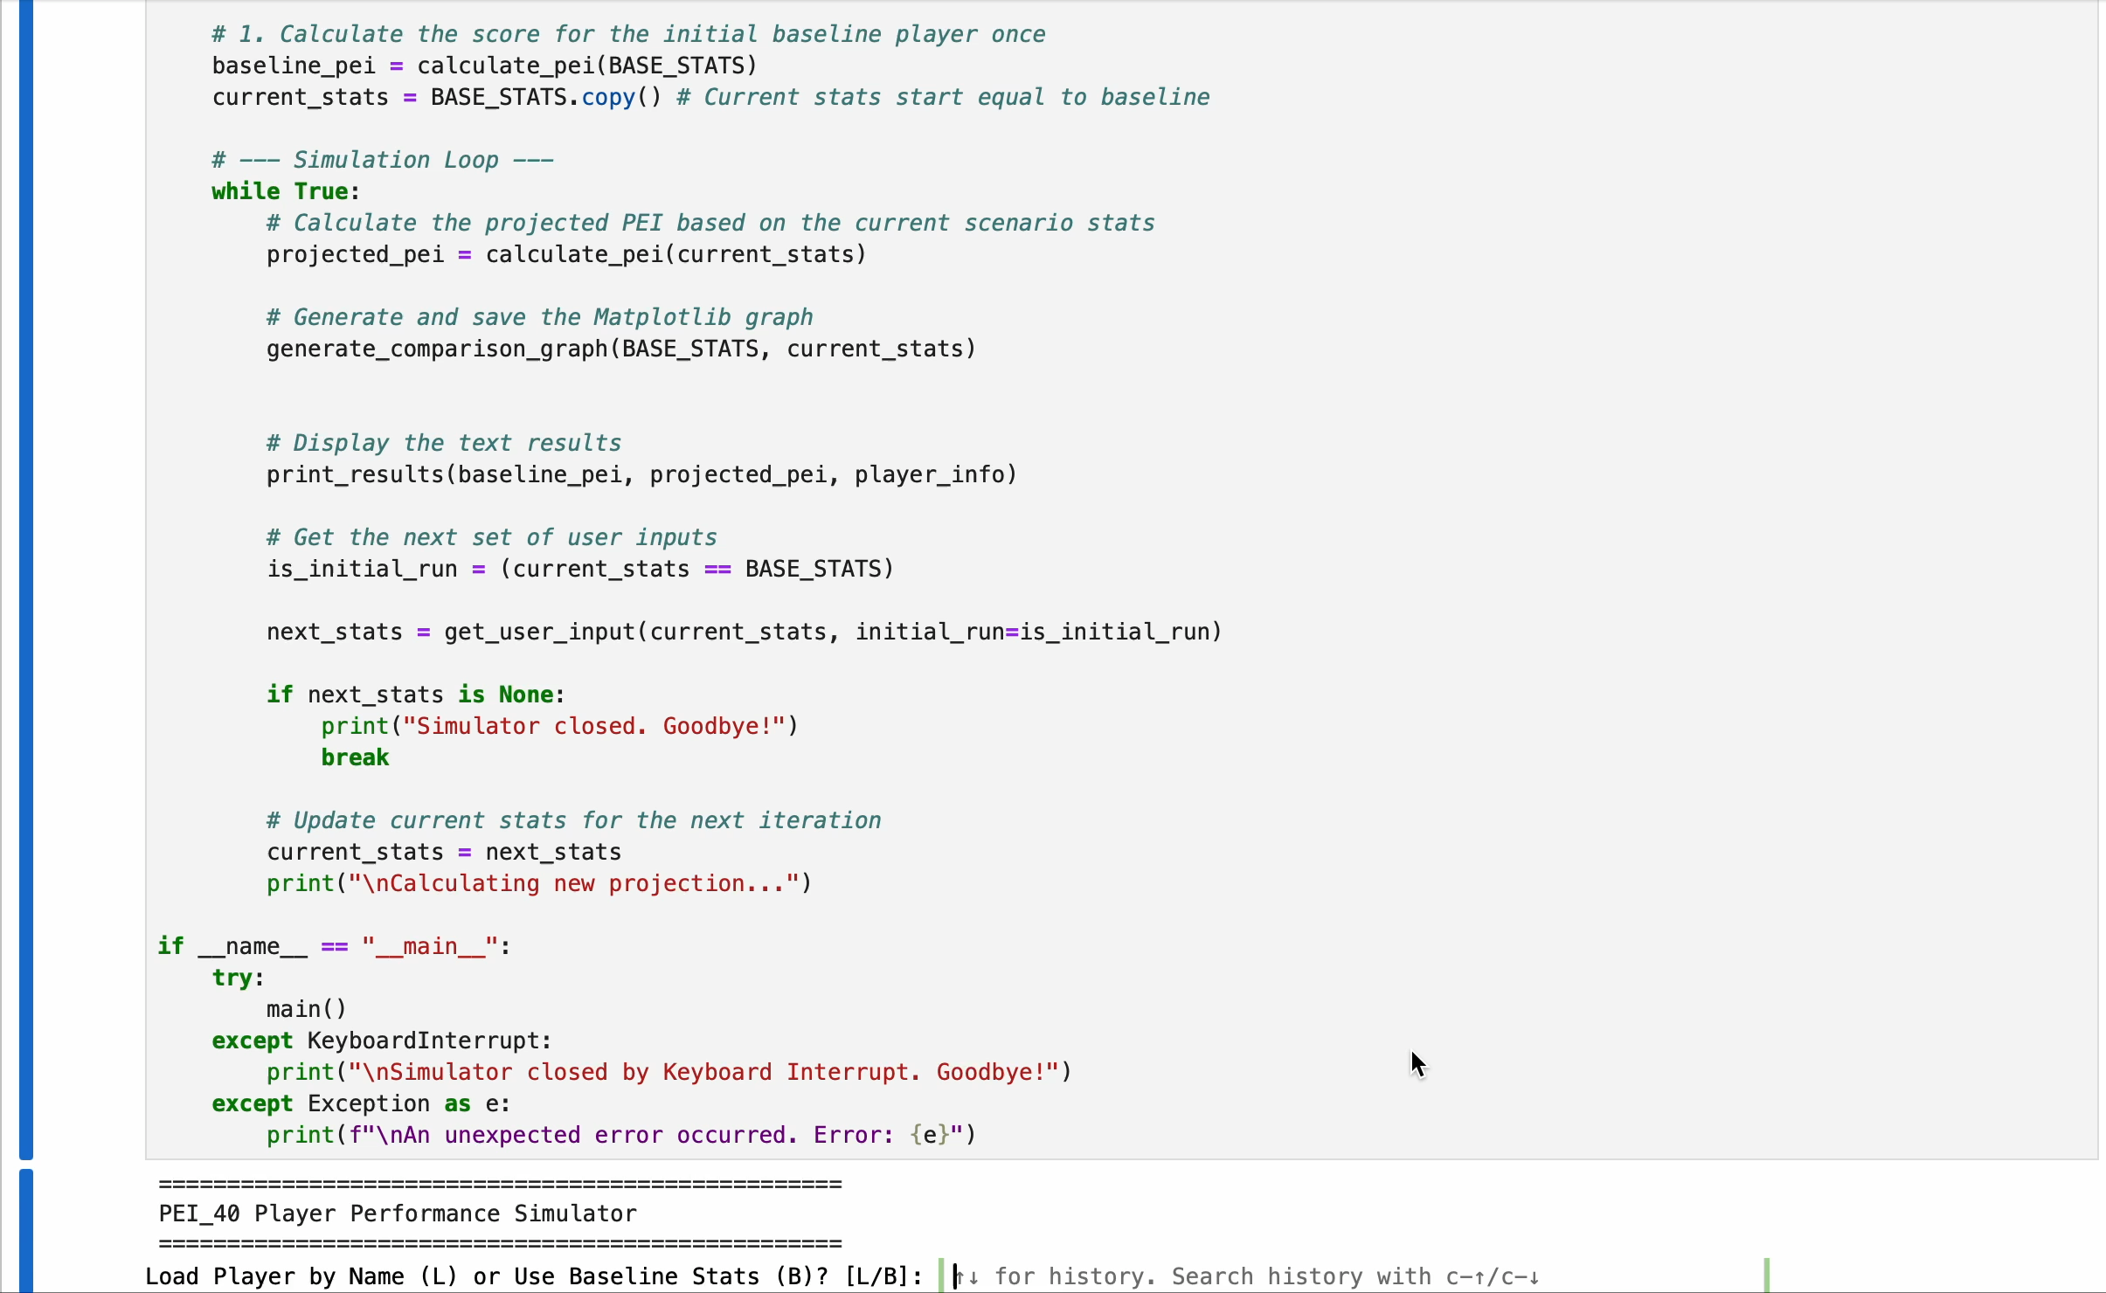
DELIVERABLE 1: ‘WHAT IF’ ENGINE
I will now show 2 simulations of player stat changes to demonstrate how my ‘What if’ Engine works
First, Here is a short video of the code in action (I haven’t developed a front end yet)
Step 1: The program will prompt the user to chose between entering a player’s name (LastName, FirstName) or using a baseline player (hard coded stats from a player slightly above average)
Step 2: Then, the program, displays the original PEI_40 and prompt the user to start the simulation or exit.
Step 3: The simulator walks through each of the 8 selected features, allowing the user to either adjust the value or keep it, by clicking the enter button
Step 4: The model outputs a comparison graph and displays the original PEI_40 and the new PEI_40 side by side, as well as printing the numbers corresponding to each, and a calculation of their difference

Slide 17
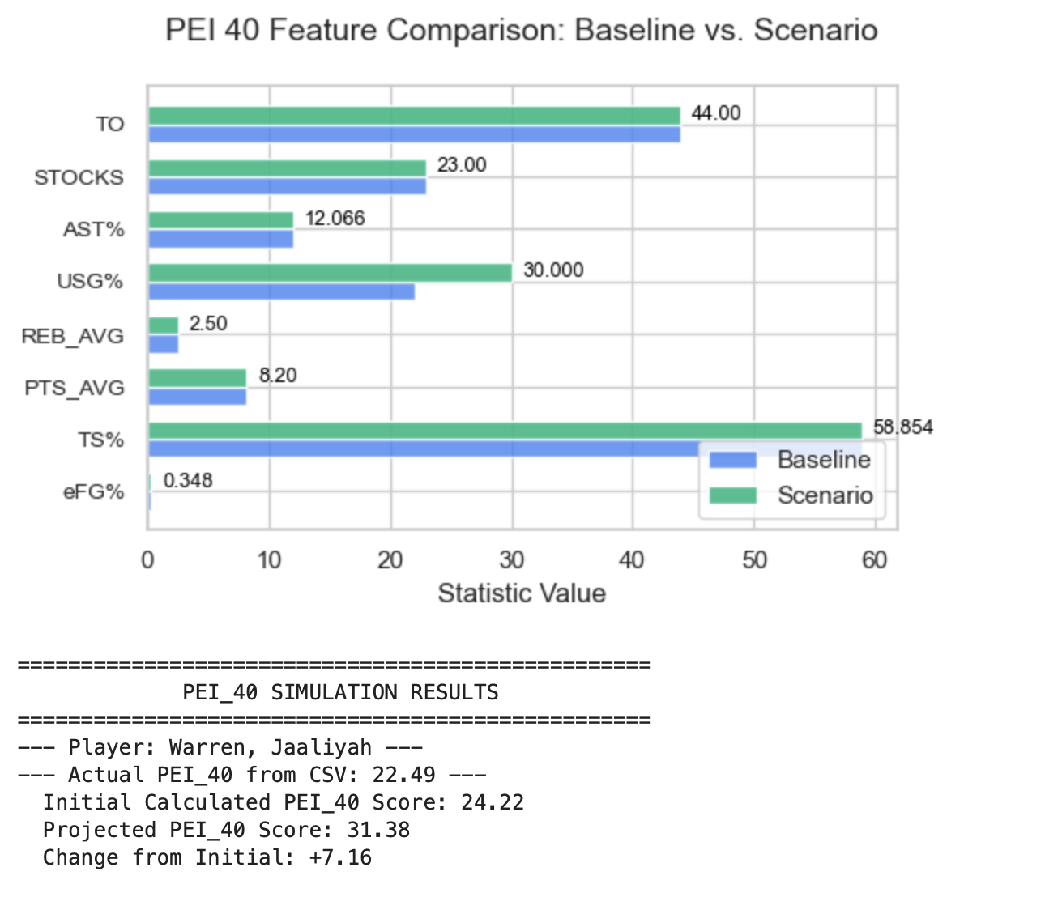
Simulation 1: Increasing the usg% of the 3rd highest ts%
I decided to simulate how an 8% increase in USG% for the team’s 3rd highest TS% would affect her PEI_40
The main reason for my decision was because, as a freshman, she ranked 3rd highest in TS%, , showing a strong long-term potential
SIMULATION RESULT
PEI_40 increased by 7.16, indicating that higher usage could significantly improve in future seasons

Slide 18
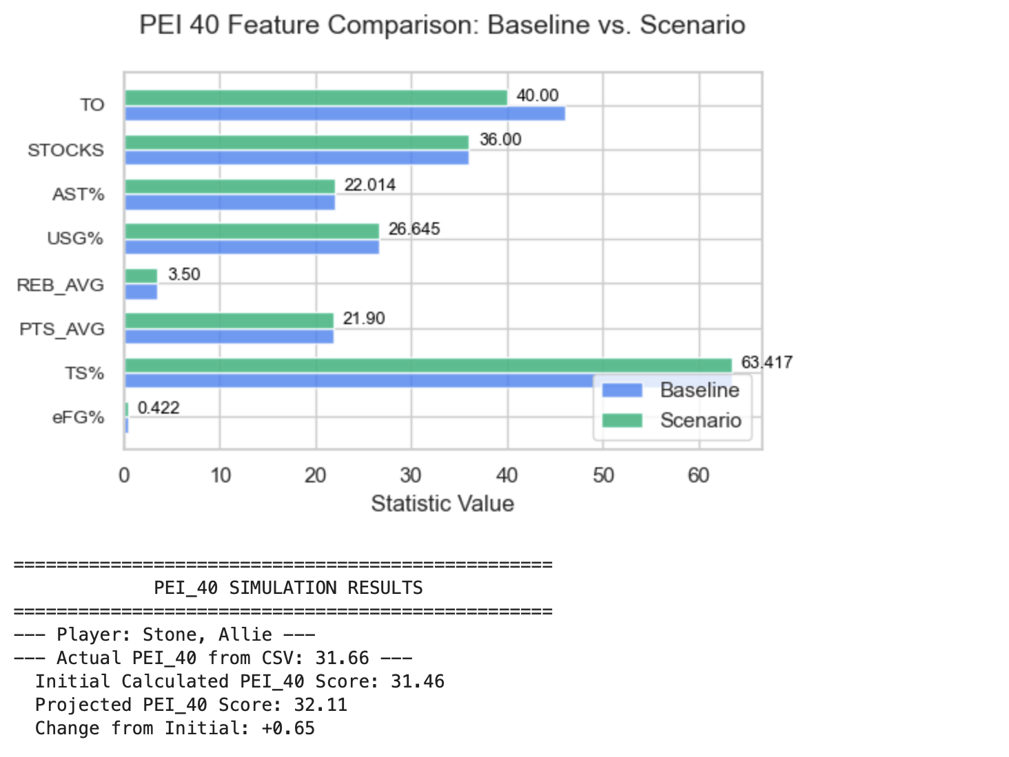
Strategic Takeaways: The Highest ROI Skills for UPIKE
For the next simulation, I examined how changing the feature with the strongest negative correlation in my model would affect our best player
I chose to reduce her turnovers (TO) by ~13% since as the starting point guard four our team, she naturally handles a high volume of possessions making her more prone to turnover the ball by sheer handling volume
SIMULATION RESULTS
The results were still meaningful: even this small decrease led to a .65 increase in her PEI_40, showing how impactful ball security can be

Slide 19
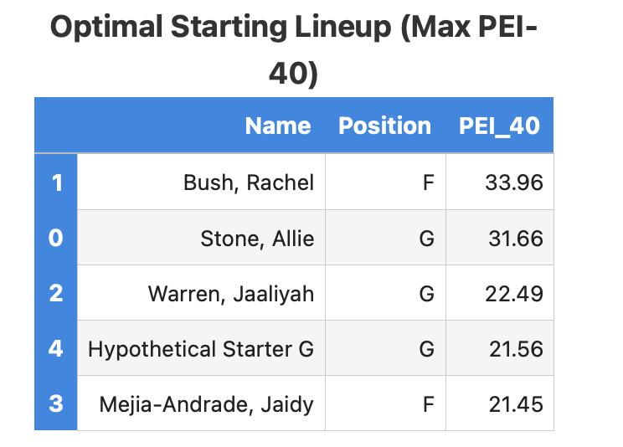
Deliverable 2: lineup simulator
As mentioned earlier, this build on Deliverable 1 and allows coaches to input PEI_40 values to generate the most efficient lineup
This simulator is still in its first version and has plenty of room for improvement, but it demonstrates how the findings of this project can support program building based on mathematical evidence
Using my code (and considering the challenge discussed on slide 15) this would be the most efficient lineup for the 2025-26 season
The results of this simulator were the most interesting finding of the project for me: it produced the exact lineup that the UPIKE basketball program is currently running
I also wanted to include freshman statistics to make this simulation even more real, but because they have only played 10 games, the sample size is too small to be statistically significant. However, this highlights how much potential there is for this model to grow and become even more impactful

Slide 20
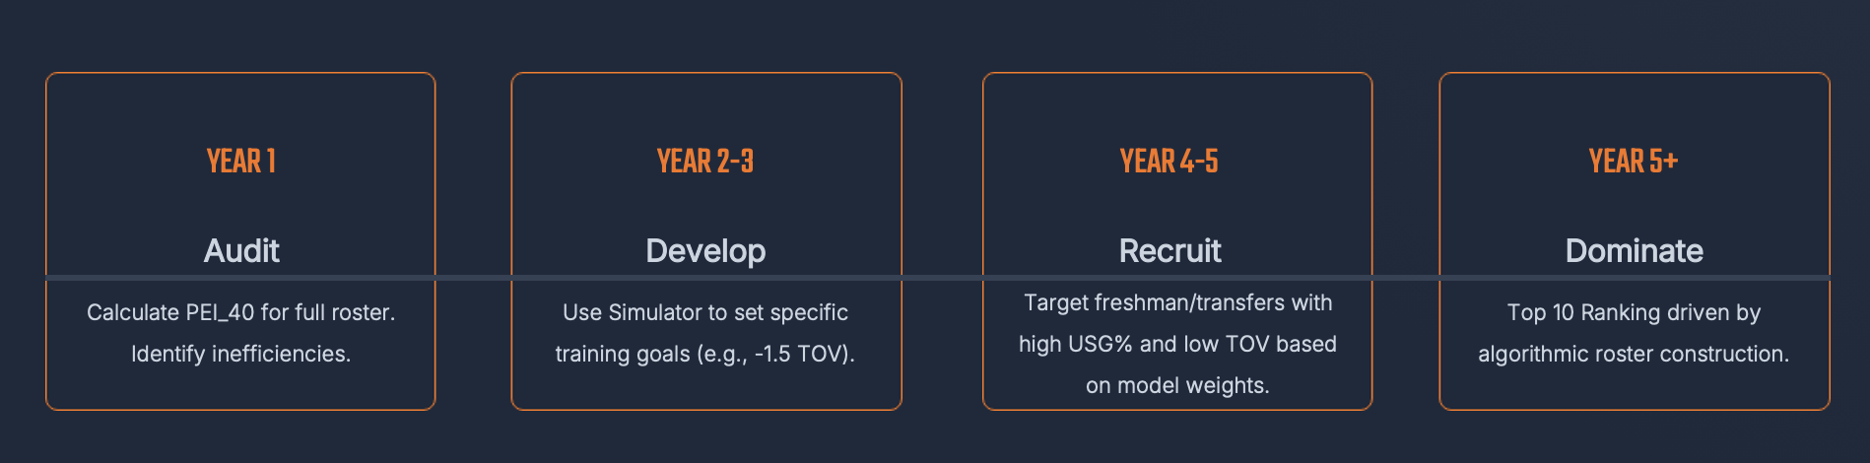
Proposed 5-year plan to success
This roadmap outlines how the PEI_40 model and simulations developed in this project could be applied over time to systematically improve a basketball program.

Slide 21
Conclusion: Efficiency, Strategy, and a Data-Driven 5-year Path to the NAIA Title
With the potential implementation of this predictive model, any basketball program can evaluate their rosters efficiency using PEI_40 and apply the 2 deliverables I built: the ‘What If’ Engine to identify areas of improvement, and the Lineup Simulator to construct a maximum-efficiency lineup
That sad, sports are played by imperfect humans, not machines, so this model should be used as a developmental reference, not as a miracle solution or absolute truth
My hypothesis is that by following the proposed 5-year plan, programs like UPIKE women’s basketball could significantly improve their national rankings and even become National Championship contenders.
This is especially realistic for UPIKE, since both the men’s and women’s teams were voted #1 in the AAC preseason pool and are favorite to win

Slide 22
sources
2018-19 Women’s Basketball Cumulative Statistics - Montana Western, University of. (2018). Montana Western, University Of. https://umwbulldogs.com/sports/womens-basketball/stats/2018-19
2020-21 Women’s Basketball Cumulative Statistics - Westmont College Athletics. (2020). Westmont College Athletics. https://athletics.westmont.edu/sports/womens-basketball/stats/2020-21
‌
‌
2021-2022 Thomas More University Women’s Basketball (PDF) - Thomas More University. (2021). Thomas More University. https://thomasmoresaints.com/sports/womens-basketball/stats/2021/pdf
‌
Clarke University. (2022). Clarke University. https://clarkepride.com/sports/wbkb/2022-23/teams/clarkeia
‌
2023 24 Women Basketball Season Stats (PDF) - Dordt University. (2023). Dordt University. https://godordt.com/documents/2024/7/22/2023-24.pdf
‌
2024 25 Women Basketball Season Stats (PDF) - Dordt University. (2024). Dordt University. https://godordt.com/documents/2024/7/22/2023-24.pdf
‌
2018-19 Women’s Basketball Cumulative Statistics - UPIKE Athletics. (2018). UPIKE Athletics. https://upikebears.com/sports/womens-basketball/stats/2018-19
2020-21 Women’s Basketball Cumulative Statistics - UPIKE Athletics. (2018). UPIKE Athletics. https://upikebears.com/sports/womens-basketball/stats/ 2020-21
‌
2021-22 Women’s Basketball Cumulative Statistics - UPIKE Athletics. (2018). UPIKE Athletics. https://upikebears.com/sports/womens-basketball/stats/ 2021-22
‌
2022-23 Women’s Basketball Cumulative Statistics - UPIKE Athletics. (2018). UPIKE Athletics. https://upikebears.com/sports/womens-basketball/stats/ 2022-23
‌
2023-24 Women’s Basketball Cumulative Statistics - UPIKE Athletics. (2018). UPIKE Athletics. https://upikebears.com/sports/womens-basketball/stats/ 2023-24
‌
2024-25 Women’s Basketball Cumulative Statistics - UPIKE Athletics. (2018). UPIKE Athletics. https://upikebears.com/sports/womens-basketball/stats/ 2024-25
Basketball Reference. (2025). Glossary | Basketball-Reference.com. Basketball-Reference.com. https://www.basketball-. reference.com/about/glossary.html?utm_source=chatgpt.com
Wikipedia Contributors. (2025, November 10). True shooting percentage. Wikipedia; Wikimedia Foundation.
‌
‌
‌
‌
NBA Efficiency Calculator (EFF). (2020). Captain Calculator. https://captaincalculator.com/sports/basketball/efficiency/?utm_source=chatgpt.com
‌

